Slide 1
3D Printing
Prepared by:
MSc. Royida A. Ibrahem Alhayali

Slide 2
Manufacturing
Additive
Subtractive
Creating A Form
Conserves Resources
Efficient
3D Printing
Uncovering A Form
Carving A Sculpture
Chiseling A Statue
Wasteful
Time Consuming

Slide 3
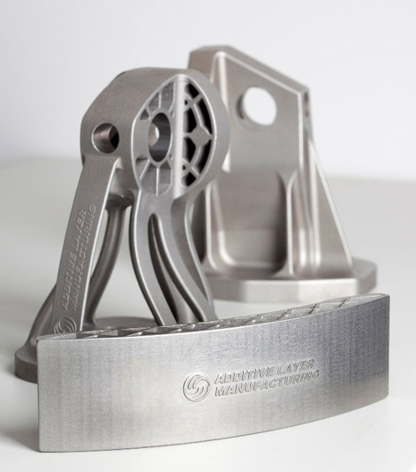
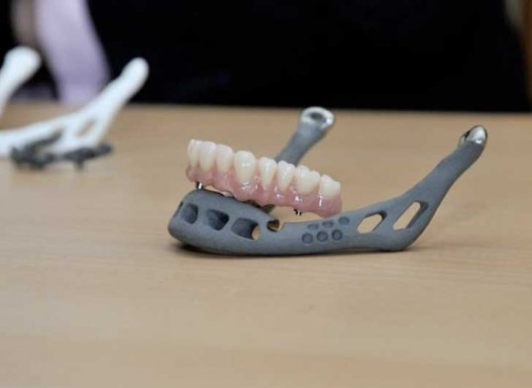
Breakthroughs
Aerospace
Medical
Wings
Replacement Parts
Designs
Copings
Joints
Tools

Slide 4
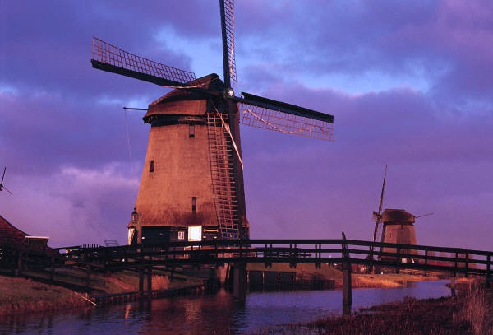
Other Industries:
Jewelry
Footwear
Architecture → → →
Engineering
Automotive
Geographic Information Systems
Civil Engineering

Slide 5
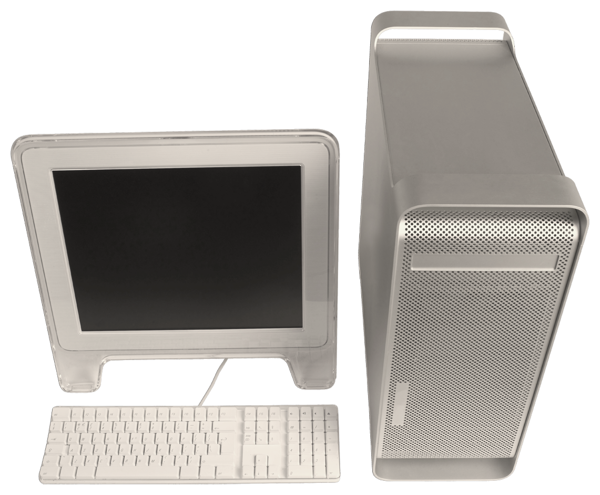
A 3D Printer
Prices range from under $5,000 to over $1,000,000
A Computer

Slide 6
The Economics
A 2.1 Billion Dollar Industry In 2012
And 6.5 Billion Dollar Industry by 2019
Number of Small 3D Printers Sold in the U.S.
Year | Units
2007 | 66
2008 | 355
2009 | 1816
2010 | 5978
2011 | 23265

Slide 7
references
Gupta, Poornima. HP's Profitable Printers to Buy Whitman Time. October 2, 2012. http://articles.chicagotribune.com/2012-10-02/business/sns-rt-us-hp-printersbre89204b-20121002_1_hp-annual-profit-lexmark (accessed November 11, 2012).
Kolet, Max Raskin and Ilan. Personal 3-D Printer Sales Jump 35,000% Since 2007. October 23, 2012. http://www.bloomberg.com/news/2012-10-24/personal-3-d-printer-sales-jump-35-000-since-2007.html (accessed November 11, 2012).
http://blog.ponoko.com/wp-content/uploads/2011/05/MG_6593_x534.jpg Accessed: November 12, 2012
http://assets.inhabitat.com/wp-content/blogs.dir/1/files/2012/02/83-3d-printed-jaw-1-537x392.jpg Accessed: November 12, 2012
http://www.createitreal.com/images/3DPrintingProcess2.gif Accesed: Novmeber 12, 2012
http://libertyinvestorcom.files.wordpress.com/2012/09/the-additive-manufacturing-revolution-begins_image.jpg?w=300 Accessed: November 12, 2012
Song: White Winter Hymnal by The Fleet Foxes. Owned by Nathan Phillips

Slide 8
Thanks for listing

